Slide 1
GLAUCOMA
By Akmal Asyiqien Adnan

Slide 2
DEFINITION
Group of diseases causing damage to the optic nerve by the effects of raised ocular pressure on the optic nerve head

Slide 3
PATHOPHYSIOLOGY
Multifactorial
Raised IOP causes mechanical damage to the axons
Raised IOP causes ischemia of the nerve axons by reducing blood flow at the nerve head

Slide 4
CLASSIFICATION
Primary glaucoma:
  Chronic open angle
  Acute and chronic closed angle
Congenital glaucoma
  Primary
  Rubella
  Secondary to inherited ocular disorders (e.g.aniridia)
Secondary glaucoma (causes)
  Trauma
  Ocular surgery
  Associated with other ocular diseases (uveitis)
  Raised episcleral venous pressure
  Steroid induced

Slide 5
PRIMARY GLAUCOMA
Classified based on whether peripheral iris covers the trabecular meshwork (open angle) or not.

Slide 6
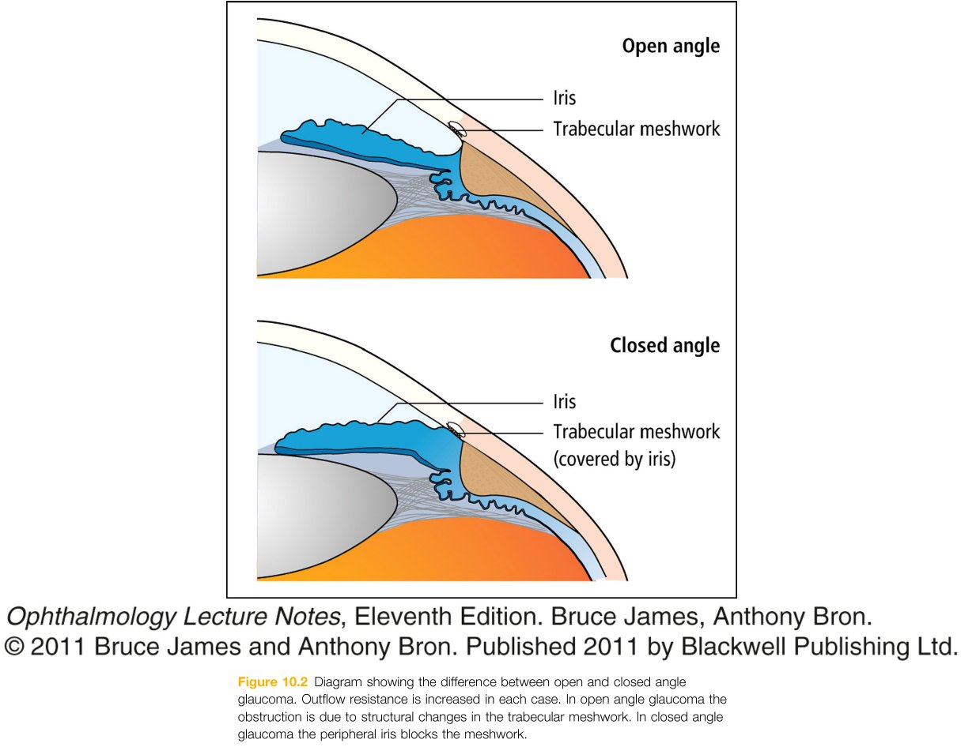

Slide 7
PRIMARY OPEN ANGLE GLAUCOMA
Also called CHRONIC OPEN ANGLE GLAUCOMA

Slide 8
PATHOGENESIS
Resistance of drainage of aqueous through the Trabecular meshwok, due to:
Thickening of trabecular lamellae, which reduces pore size.
Reduction in number of lining trabecular cells.
Increased extracellular material in the trabecular meshwork spaces

Slide 9
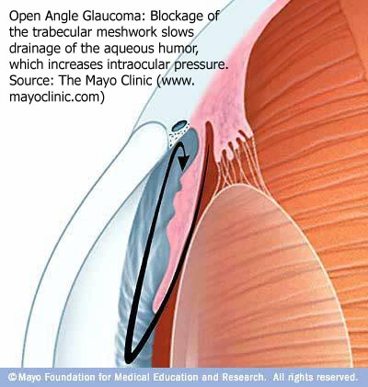

Slide 10
EPIDEMIOLOGY
Most common type of glaucoma
1 in 200 of >40, male=female
Prevalence increase with age, 10% in over-80
May be a family history, though mode of inheritance is unclear

Slide 11
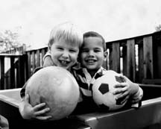
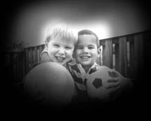
HISTORY
ASYMPTOMATIC in early stages
Visual field defect
Visual deficit

Slide 12
EXAMINATION
White eyes and clear cornea
Tonometer : Ocular pressure is 22-40mmHg range (normal = 11-21mmHg)
Cup:disc ratio >0.4
Gonioscopy to confirm open angle

Slide 13
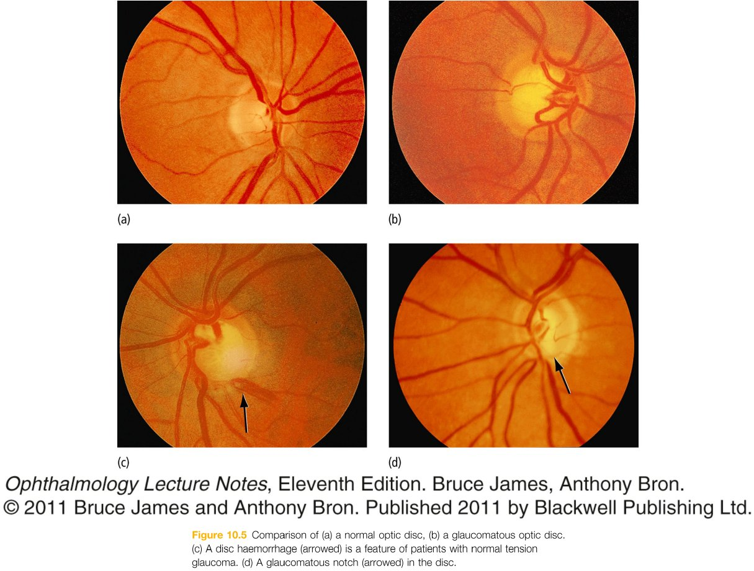

Slide 14
TREATMENT
Aim to reduce IOP
Medical
Laser
Surgery

Slide 15
Medical treatment
Prostaglandin analogues (1st line)
increase the passage of aqueous through uveoscleral pathway
Topical adrenergic B-blocker
-suppress aqueous secretion

Slide 16
Category | MOA | Drugs | Side effect
Β-adrenergic blockers | Decrease aqueous formation | Timolol Levobunolol Metrapranolol | systemic effect (bronchospasm, bradycardia, heart block, hypotension..)
Cholinergic stimulation | Increase aqueous outflow | Pilocarpine Carbachol | Miosis, decrease night vision, headache, increase GI motility, decreased heart rate
Adrenergic stimulating | Both | Epinephrine HCl Dipivitrin Brimonidine | Contact allergy, hypotension in children
Carbonic anhydrase inhibitor | Decrease aqueous formation | Oral acetazolamide Topical dorzolamide | Renal calculi, nausea, vomiting, diarrhea, weight loss, aplastic anemia, BM suppression S/E generally absent with topical preparation
Prostaglandin agonists | Improve uveoscleral outflow | Latanoprost, Travaprost | Iris color change, lash growth, trichiasis

Slide 17
If IOP remains elevated, the choice lies between
Adding additional medical treatment
Laser treatment
Surgical drainage procedures

Slide 18
Laser trabeculoplasty
Laser burns (50μm) in the trabecular meshwork to improve aqueous flow
Whilst effective initially, IOP may slowly increase

Slide 19
Surgical treatment
Drainage surgery ( Trabeculectomy ) by creating a fistula between the anterior chamber and the subconjunctival space

Slide 20
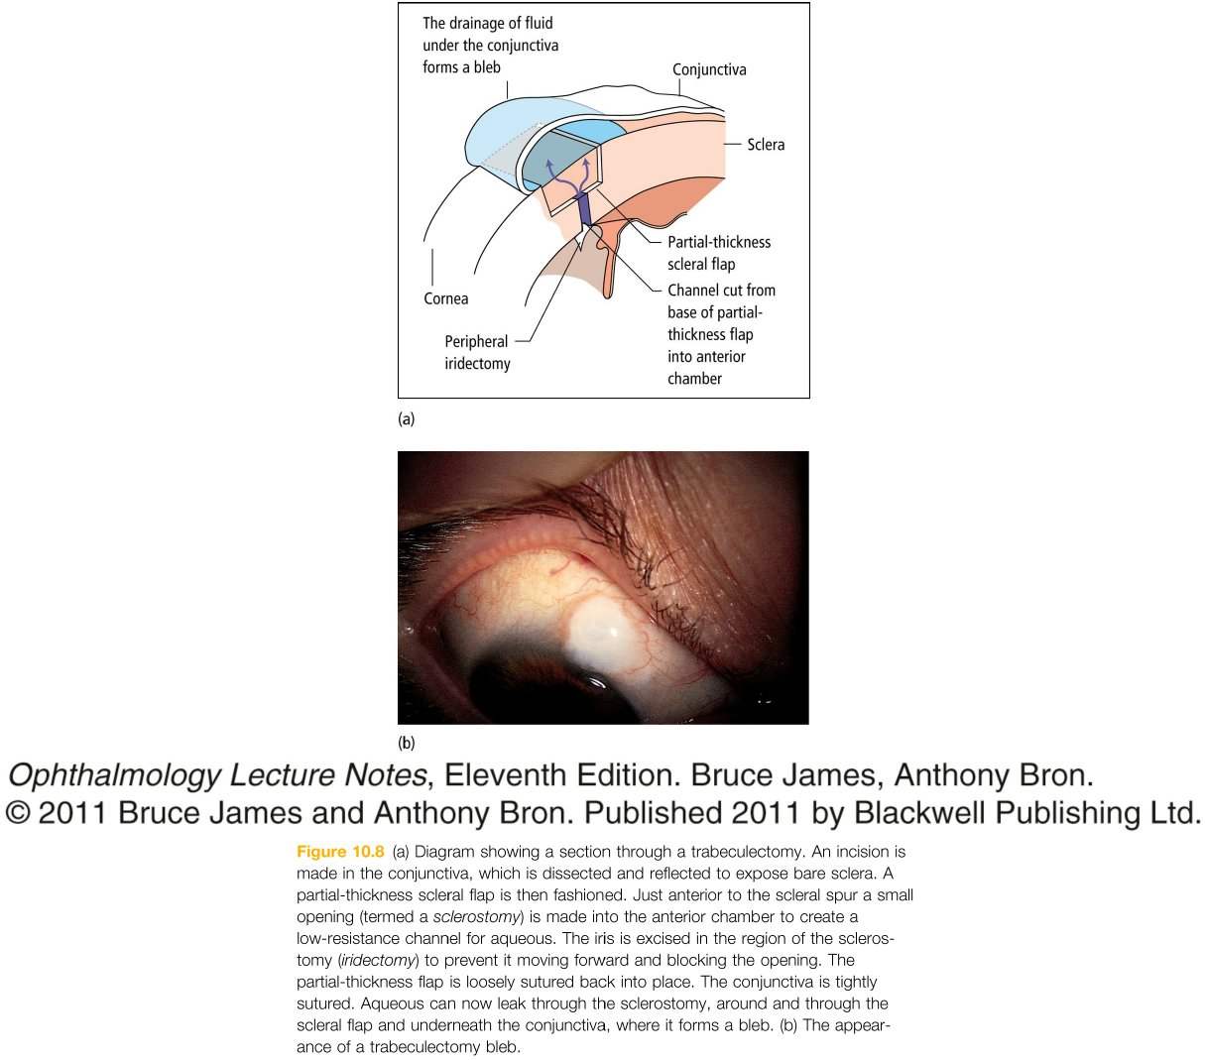

Slide 21
Complication
Shallowing of anterior chamber → risking damage to cornea and lens
Intraocular infection
Possibly accelerated cataract formation
Failure to reduce IOP adequately
Hypotony which may cause macular edema

Slide 22
PRIMARY ANGLE CLOSURE GLAUCOMA

Slide 23
EPIDEMIOLOGY
Affects 1 in 1000 subjects over 40 years old
Females > males
Are likely long-sighted

Slide 24
PATHOPHYSIOLOGY
W hen the iris is dilated, the lens sticks to the back of the iris causing obstruction of fluid flow from posterior to anterior chambers.
R educed/ stagnant circulation deprives the whole cornea of its nutrition and posterior cornea of its O2
This causes failure of endothelial pumping function and a massive degree of corneal edema and clouding
Amplified by increase IOP → profound fall in vision

Slide 25
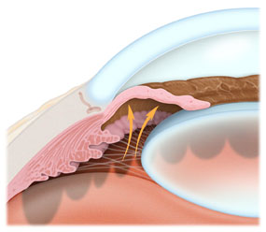

Slide 26
HISTORY
Abrupt increase in pressure so it’s very painful due to ischemic tissue damage
Photophobia
Watering of the eye
Blurred vision
Systemically unwell (nausea, abdominal pain)

Slide 27
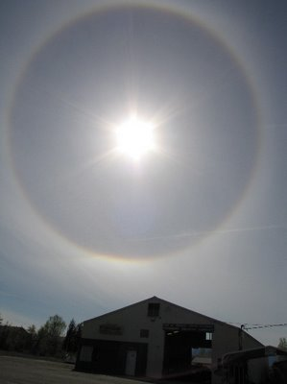
Intermittent primary angle closure glaucoma occurs when acute attack spontaneously resolves.
Pain
Blurring of vision
Frontal feadache
Coloured halo around bright lights

Slide 28
EXAMINATION
Reduced visual acuity
Red eye, cloudy cornea, pupil oval, fixed and dilated
Tonometry: elevated IOP (40-80mmHg)
Ophthalmoscopy: swollen optic disc

Slide 29
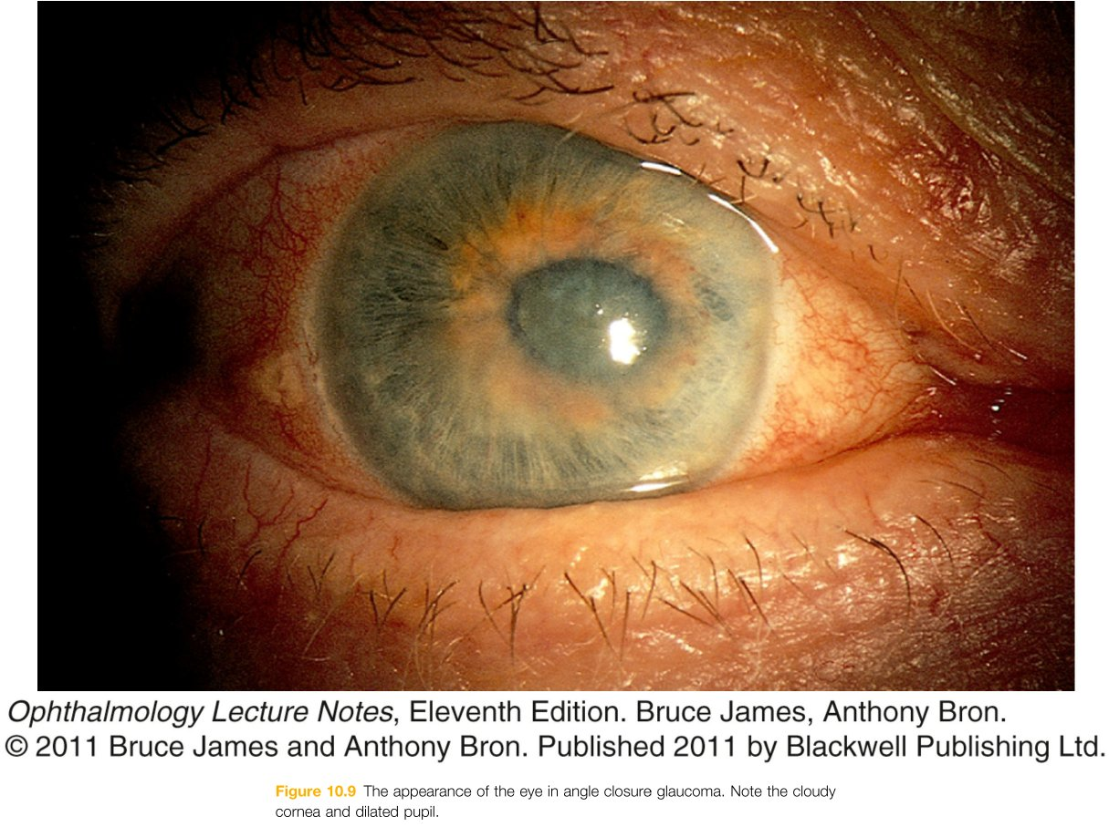

Slide 30
TREATMENT
URGENT
IV acetazolamide together with topical pilocarpine and B-blocker
Iridotomy or iridectomy in peripheral iris to prevent further attacks. Can be done with YAG laser or surgically

Slide 31
S ECONDARY GLAUCOMA

Slide 32
Rise in IOP usually due to trabecular meshwork obstruction
Signs and symptoms depend on rate of IOP rises
Treat underlying causes
Causes :
Trauma
Uveitis
Pigment dispersion syndrome
Pseudoexfoliative glaucoma
Steroid induced
Complication of diabetes

Slide 33
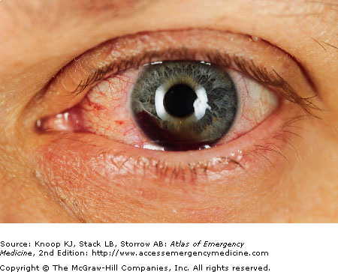
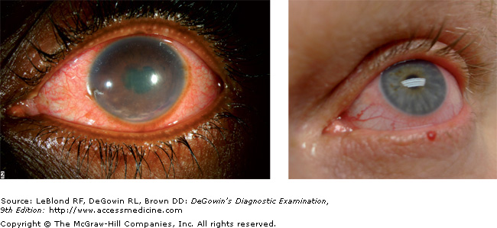
Hyphema, following blunt trauma
Uveitis

Slide 34
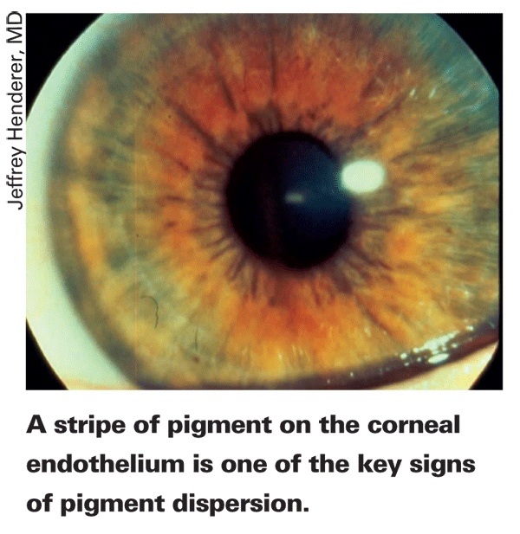
PIGMENT DISPERSION SYNDROME
Glaucoma may develop as a result of the breakdown and flaking off of the coloring (pigment) found in the iris and the part of the eye that produces fluid (ciliary body). These flakes of pigment block the fluid drainage system of the eye. This type of secondary glaucoma is called pigmentary glaucoma

Slide 35
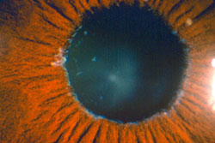
PSEUDOEXFOLIATIVE GLAUCOMA
Another type of common secondary glaucoma can occur when a different type of flaky material is produced in the eye. The origin of this white, flaky material is not clearly known but it can block the fluid drainage system of the eye. This type of secondary glaucoma is called pseudoexfoliation glaucoma or exfoliation syndrome
Notes:
Diagnosis of PXFG is made by identifying the abnormal material, which looks a bit like dandruff flakes, on the iris or lens. It is important to have the pupils dilated, as the material may be missed otherwise. Visualizing the material can be difficult, particularly early on in the disease, and it may not be found until years after the diagnosis of glaucoma is made. The presence of pseudoexfoliation, and the associated risk of glaucoma, increases with age.

Slide 36
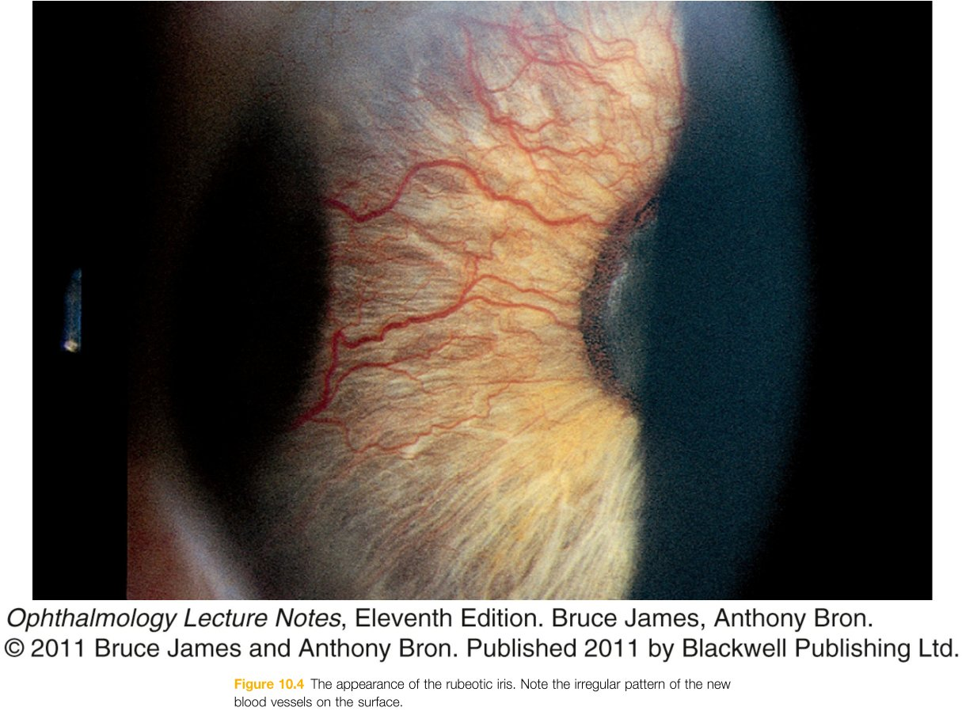
ABNORMAL BLOOD VESSEL
Abnormal iris blood vessels may obstruct angle and cause the iris to adhere to peripheral cornea, closing the angle (rubeosis iridis).

Slide 37
CONGENITAL GLAUCOMA

Slide 38
Cause remains uncertain. Theory : angle is developmentally abnormal and covered with membrane
May present at birth or within 1st year of life
Congenital glaucoma may be found in association with congenital cataract extraction, inflammation, injury, or in conjunction with other syndromes or diseases

Slide 39
SYMPTOMS AND SIGNS
Excessive tearing, photophobia and blepharospasm
Increased corneal diameter and enlargement of the globe (buphthalmos)
Cloudy cornea
Splits in Descemet’s membrane

Slide 40
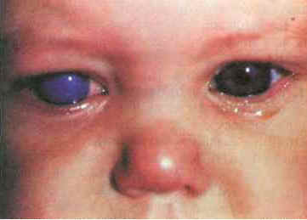

Slide 41
TREATMENT
Treated surgically
Goniotomy – incision into trabecular meshwork
Trabeculotomy – direct passage between Schlemm’s canal and anterior chamber

